Slide 1

Date: | Human Biology Year 12 ATAR
Do Now Past exam question Lesson Agenda 1: Do Now 2: Homeostasis when body temperature rises 3: Consequences when tolerance limits are exceeded 4: Fever and body temperature 5: Lesson summary Suggested Study Compulsory: Complete review worksheet, mark and correct using answer key on Connect. Read through today’s notes and textbook section NEXT LESSON Past Exam Question Homeostasis when body temperature rises Disruptions to temperature homeostasis Fever | Learning Aims Describe body responses when the body temperature rises above the set point Draw detailed homeostatic feedback loops (steady-state control diagrams) for aspects of thermoregulation when body temperature rises. Discuss consequences to the body when tolerance limits for temperature are breached. Discuss why fever occurs and the physiological processes involved.
 | Key Vocabulary Homeostasis Steady State Control Model Homeostatic Feedback Loop Thermoregulation Pyrogen

Slide 2

Body Temperature Homeostasis
Thermoregulation when body temperature rises
Chapter 5 Human Perspectives

Slide 3
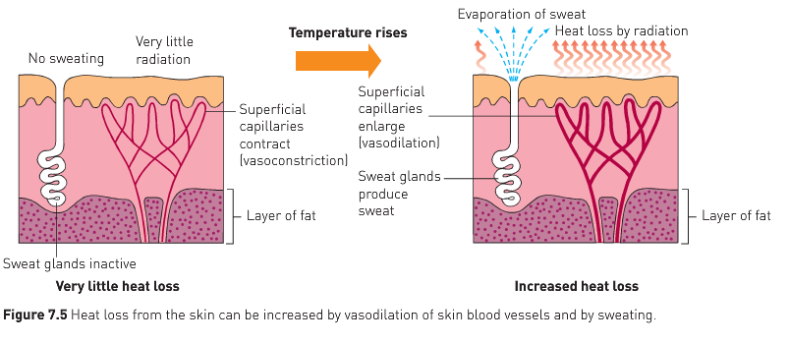
Responses when body temperature rises above set point
Vasodilation
Hypothalamus receives messages from thermoreceptors and initiates cooling response via autonomic NS.
Blood vessels in skin dilate
More blood can move through
Allows heat to be lost to surrounding environment
Learning Aim: Describe body responses when the body temperature rises above the set point

Slide 4
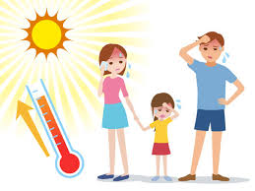
Responses when body temperature rises above set point
Sweating
Hypothalamus receives messages from thermoreceptors and initiates cooling response via autonomic NS.
Needed for environmental temps above 28ºC
Only option for cooling if environment above 37ºC
Evaporation of liquid from skin accelerates heat transfer from body to environment
Works better in low humidity
Learning Aim: Describe body responses when the body temperature rises above the set point

Slide 5

Responses when body temperature rises above set point
Conscious behavioural responses
Cerebral cortex receives information from thermoreceptors and initiates cooling response via the somatic motor NS (so we use our muscles to take action):
Wearing fewer clothing layers
Seeking cooler environments
Reducing physical activity
Learning Aim: Describe body responses when the body temperature rises above the set point

Slide 6
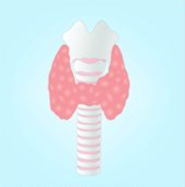
Responses when body temperature rises above set point
Endocrine system – Thyroid
Rise in body temperature detected by thermoreceptors
Hypothalamus receives message and initiates response
Inhibits messages to thyroid (via the anterior pituitary) to inhibit thyroxine production
Less thyroxine means lower metabolic rate, so less heat produced.
This tends to be a much longer-term response: seasonal.
Learning Aim: Describe body responses when the body temperature rises above the set point

Slide 7
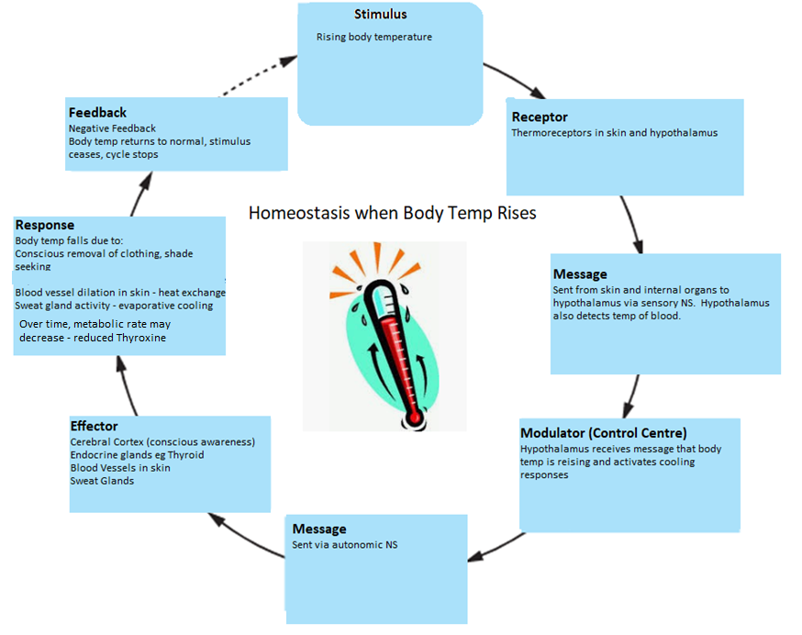
Learning Aim: Draw detailed homeostatic feedback loops (steady-state control models) for thermoregulation when body temperature rises.

Slide 8
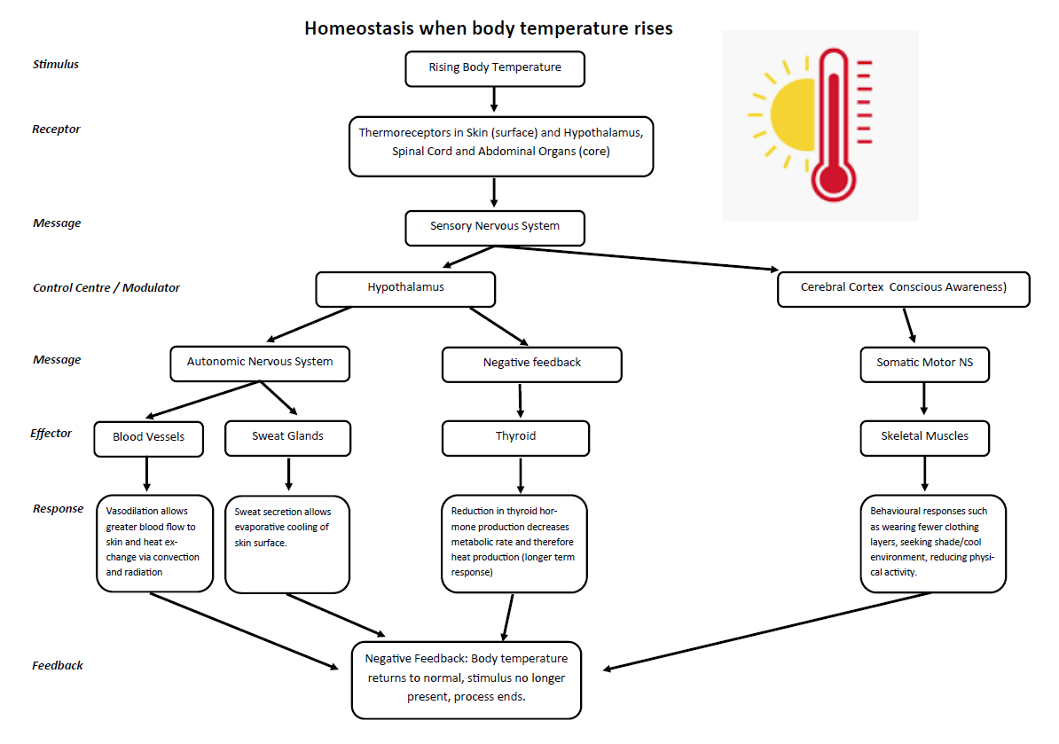
Learning Aim: Draw detailed homeostatic feedback loops (steady-state control models) for thermoregulation when body temperature rises.

Slide 9
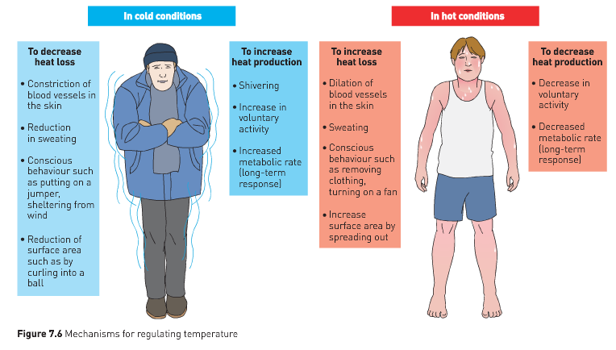

Slide 10
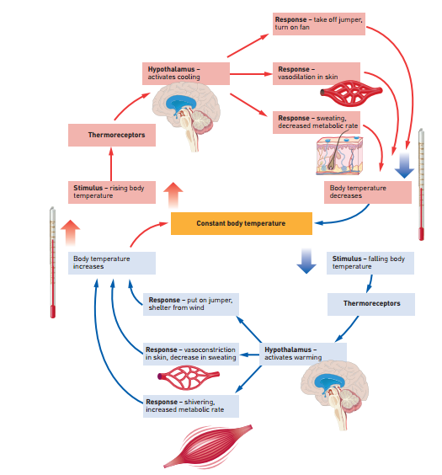

Slide 11
Consequences when tolerance limits are exceeded.
Core body temp above 42ºC is dangerous and will result in death if prolonged.
Heat stroke:
when the body is unable to manage temperature due to extreme external conditions, and core body temperature rises above tolerance limits.
Treatment – careful cooling.
Heat exhaustion:
Less severe
Dehydration from sweating + vasodilation → drop in BP and fainting.
Core body temperature may not change – it’s a drop in BP because of the normal cooling responses.
Treatment – help patient to feel cooler (cold compress, cool drink) and give fluids.
Hypothermia:
If body temperature drops below 32ºC.
Death if prolonged
Treatment – careful, slow warming.
Learning Aim: Discuss consequences to the body when tolerance limits for body temperature are breached.

Slide 12
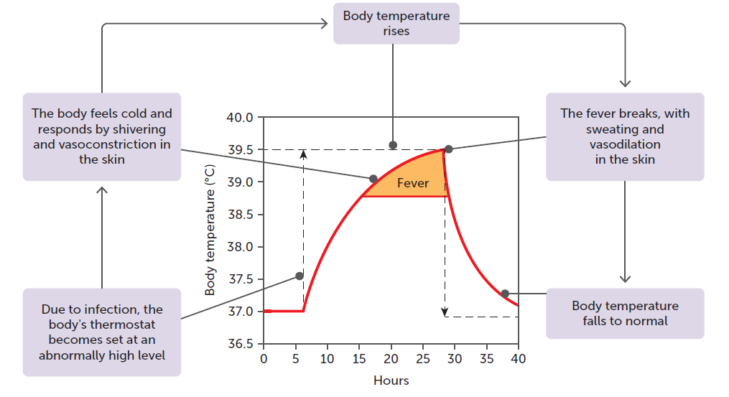
Fever – a response that raises core body temperature
Part of the body’s natural immune response to infection.
Body raises temperature to combat pathogens such as viruses or bacteria.
After encountering infection, white blood cells release pyrogens (fever causing chemicals) eg: interleukin-1
Pyrogens affect the hypothalamus so that the normal set point of 37ºC is temporarily reset to a higher temperature.
Hypothalamus then initiates warming responses to raise body temperature to the new, temporary set point.
These include normal warming responses such as shivering, vasoconstriction, seeking warmth etc, until the body temperature reaches the new “set point”.
Once the infection has been dealt with, the immune system stops producing pyrogens, and the “set point” returns to normal.
The person then feels hot and cooling responses are activated eg sweating and vasodilation.
Fever is beneficial, but only up to a point. Prolonged, high fever can cause harm and even death, if the immune system is unable deal with the infection quickly and effectively.
Learning Aim: Discuss why fever occurs and the physiological processes involved.

